Slide 1

GNV to the World in One Stop
Nonstops to ATL, CLT, DFW and MIA
One Stop to 341 destinations around the globe!

Slide 2
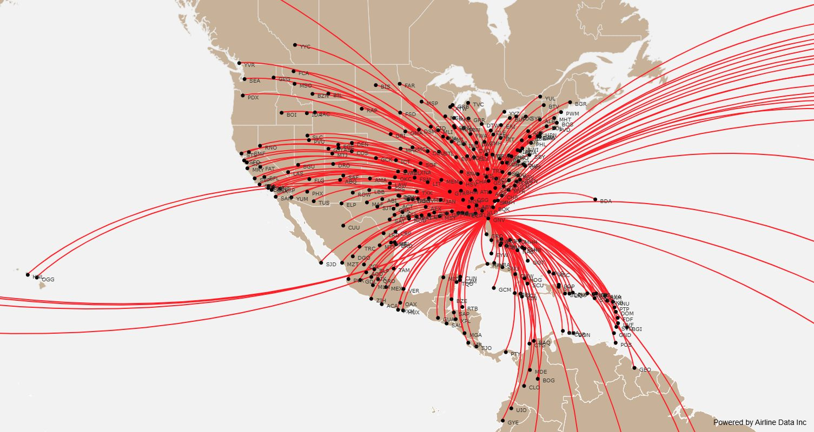
GNV One-Stop Connections – North America View
CLT
DFW
ATL
GNV
MIA

Slide 3
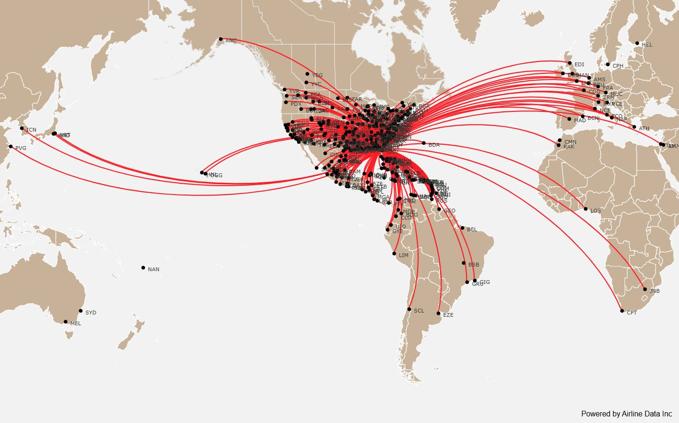
GNV One-Stop Connections Plus Codeshare One-Stops – World View

Slide 4
ABI Abilene, TX•ACA Acapulco, Mexico•AGU Aguascalientes, Mexico•CAK Akron, OH•ABY Albany, GA•ALB Albany, NY• ABQ Albuquerque, NM • AEX Alexandria, LA • ABE Allentown/Bethlehem/Easton PA•AMA Amarillo, TX•AMM Amman, Jordan•AMS Amsterdam, Netherlands•ANC Anchorage, AK•AXA Anguilla, Anguilla •ANU Antigua, Antigua and Barbuda• ATW Appleton, WI • AUA Aruba, Aruba•AVL Asheville, NC •HTS Ashland, WV •ASE Aspen, CO •ATH Athens, Greece •ATL Atlanta, GA •AGS Augusta, GA •AUS Austin, TX •BFL Bakersfield, CA •BWI Baltimore, MD •BGR Bangor, ME •BGI Barbados/Bridetown, Barbados •BCN Barcelona, Spain •BAQ Barranquilla, Colombia •BTR Baton Rouge, LA •BPT Beaumont/Port Arthur, TX •BEL Belem, Brazil •BZE Belize City, Belize •BIL Billings, MT •BIM Bimini, Bahamas •BHM Birmingham, AL •BIS Bismarck/Mandan, ND •BMI Bloomington/Normal,IL •BOG Bogota, Colombia •BOI Boise, ID •BON Bonaire, St. Eustatius & Saba •BOS Boston, MA •BZN Bozeman, MT •BSB Brasilia, Brazil •TRI Bristol/Kingsport/Johnson City, TN •BRO Brownsville, TX •BQK Brunswick, GA •BRU Brussels, Belgium •EZE Buenos Aires, Argentina •BUF Buffalo, NY •BUR Burbank, CA •BTV Burlington, VT •YYC Calgary, Alberta•CLO Cali, Colombia •CMW Camaguey, Cuba•CUN Cancun, Mexico•Capetown, South Africa•CTG Cartagena, Colombia•CMN Casablanca, Morocco•CID Cedar Rapids/Iowa City, IA•CMI Champaign/Urbana, IL•CHS Charleston, SC•CRW Charleston/Dunbar, WV•STT Charlotte Amalie, VI •CLT Charlotte, NC•CHO Charlottesville, VA•CHA Chattanooga, TN•MDW Chicago, IL•ORD Chicago, IL•CUU Chihuahua, Mexico•CVG Cincinnati, OH•CLE Cleveland, OH •CLL College Station/Bryan, TX•COS Colorado Springs, CO•COU Columbia, MO•CAE Columbia, SC•CSG Columbus, GA•GTR Columbus, MS•CMH Columbus, OH•XPL Comayagua, Honduras•CPH Copenhagen, Denmark•CRP Corpus Christi, TX•CZM Cozumel, Mexico•CUR Curacao, Netherlands Antilles•DAL Dallas, TX•DFW Dallas/Ft. Worth, TX•DAY Dayton, OH•DEN Denver, CO•DSM Des Moines, IA•DTW Detroit, MI•DIA Doha, Qatar•DOM Dominica, Dominica•DHN Dothan, AL•DUB Dublin, Ireland•DRO Durango, CO•DGO Durango, Mexico•EGE Eagle, CO•EDI Edinburgh, UK•YEG Edmonton, Alberta•ELP El Paso, TX•ERI Erie, PA•EVV Evansville, IN•FAR Fargo, ND•XNA Fayetteville, AR•FAY Fayetteville, NC•FLG Flagstaff, AZ•FLO Florence, SC•FDF Fort De France, Martinique•FLL Fort Lauderdale, FL•RSW Fort Myers, FL•FSM Fort Smith, AR•FWA Fort Wayne, IN•FRA Frankfurt, Germany•FPO Freeport, Bahamas•FAT Fresno, CA•GCK Garden City, KS•GEO Georgetown, Guyana•GHB Governors Harbour, Bahamas•GCM Grand Cayman, Cayman Islands•GRI Grand Island, NE•GJT Grand Junction, CO•GRR Grand Rapids, MI•GRB Green Bay, WI•GSO Greensboro/High Point, NC•PGV Greenville, NC•GSP Greenville/Spartanburg, SC•GDL Guadalajara, Mexico•GUA Guatemala City, Guatemala•GYE Guayaquil, Ecuador•GPT Gulfport/Biloxi, MS•BDA Hamilton, Bermuda•HRL Harlingten/San Benito, TX•MDT Harrisburg, PA•BDL Hartford, CT•HAV Havana, Cuba•HEL Helsinki, Finland•HHH Hilton Head, SC•HOG Holguin, Cuba•HNL Honolulu, HI•HOU Houston, TX•IAH Houston, TX•HSV Huntsville, AL•IDA Idaho Falls, ID•IND Indianapolis, IN•ZIH Ixtapa/Zihuatanejo, Mexico•JAC Jackson, WY •JAN Jackson/Vicksburg, MS •OAJ Jacksonville/Camp Lejeune, NC •JNB Johannesburg, South Africa •OGG Kahului, HI •FCA Kalispell, MT •MCI Kansas City, MO •EYW Key West, FL •GRK Killeen, TX •KIN Kingston, Jamaica •TYS Knoxville, TN •LRM La Romana, Dominican Republic •LFT Lafayette, LA •LOS Lagos, Nigeria •LCH Lake Charles, LA •LRD Laredo, TX •LAS Las Vegas, NV •LAW Lawton/Ft. Sill, OK •BJX Leon-Guanajuato, Mexico •LWB Lewisburg, WV •LEX Lexington, KY •LIR Liberia, Costa Rica •LIM Lima, Peru •LIT Little Rock, AR •

Slide 5
LHR London, UK•GGG Longview, TX•LAX Los Angeles, CA•SDF Louisville, KY•LBB Lubbock, TX•LYH Lynchburg, VA• MSN Madison, WI• MAD Madrid, Spain • MGA Managua, Nicaragua•MHT Manchester, NH•MAN Manchester, UK•MHK Manhattan/Ft. Riley, KS•RAK Marrakech, Morocco•MHH Marsh Harbour, Bahamas•MZT Mazatlan, Mexico• MDE Medelin, Colombia • MEL Melbourne, Australia•MEM Memphis, TN•MID Merida, Mexico •MEX Mexico City, Mexico•MIA Miami, FL •MAF Midland/Odessa, TX•MXP Milan, Italy•MKE Milwaukee, WI•MSP Minneapolis/St. Paul, MN•MFE Mission/McAllen/Edinburg, TX•MSO Missoula, MT•MOB Mobile, AL•MLI Moline, IL•MLU Monroe, LA•MBJ Montego Bay, Jamaica•MRY Monterey, CA•MTY Monterey, Mexico•MGM Montgomery, AL•YUL Montreal, Quebec•MTJ Montrose/Delta, CO•MLM Morelia, Mexico •GGT Moss Town, Bahamas•MUC Munich/Augsburg, Germany•MYR Myrtle Beach, SC •NAN Nadi, Fiji Islands•NAP Naples, Italy •BNA Nashville, TN•NAS Nassau, Bahamas•EWN New Bern/Morehead/Beaufort, NC•MSY New Orleans, LA•JFK New York, NY•LGA New York, NY•EWR Newark, NJ•PHF Newport News/Williamsburg, VA•NCE Nice, France•ORF Norfolk, VA•ELH North Eleuthera, Bahamas•OAX Oaxaca, Mexico•OCJ Ocho Rios, Jamaica•OKC Oklahoma, City, OK•OMA Omaha, NE•ONT Ontario, CA•PSP Palm Springs, CA•ECP Panama City, FL•PTY Panama City, Panama Republic•CDG Paris, France•PNS Pensacola, FL•PIA Peoria, IL•PHL Philadelphia, PA•SXM Philipsburg, Sint Maarten•PHX Phoenix, AZ•PIT Pittsburgh, PA•PTP Pointe A Pitre, Guadeloupe•POS Port of Spain, Trinidad and Tobago•PWM Portland, ME•PDX Portland, OR•PVD Providence, RI•PLS Providenciales, Turks and Caicos Islands•PVU Provo, UT•PXM Puerto Escondido, Mexico•POP Puerto Plata, Dominican Republic•PVR Puerto Vallarta, Mexico•PUJ Punta Cana, Dominican Republic•QRO Queretaro, Mexico•UIO Quito, Ecuador•RDU Raleigh/Durham, NC•RAP Rapid City, SD•RNO Reno, NV•RIC Richmond, VA•GIG Rio De Janeiro, Brazil•ROA Roanoke, VA•RTB Roatan Island, Honduras•ROC Rochester, NY•FCO Rome, Italy•ROW Roswell, NM•SMF Sacramento, CA•SBY Salisbury, MD•SLC Salt Lake City, UT•SJT San Angelo, TX•SAT San Antonio, TX•SAN San Diego, CA•SFO San Francisco, CA•SJD San Jose Del Cabo, Mexico•SJC San Jose, CA•SJO San Jose, Costa Rica•SJU San Juan, Puerto Rico•SBP San Luis Obispo, CA•SLP San Luis Potosi, Mexico•SAP San Pedro Sula, Honduras•SAL San Salvador, El Salvador•SNA Santa Ana, CA•SBA Santa Barbara, CA•SNU Santa Clara, Cuba•HUX Santa Cruz Huatulco, Mexico•SAF Santa Fe, NM•STS Santa Rosa, CA•SCL Santiago, Chile•SCU Santiago, Cuba•STI Santiago, Dominican Republic•SDQ Santo Domingo, Dominican Republic•GRU Sao Paulo, Brazil•SRQ Sarasota/Bradenton, FL•SAV Savannah, GA•AVP Scranton/Wilkes-Barre, PA•SEA Seattle, WA•ICN Seoul, Republic of Korea•PVG Shanghai, China•FSD Sioux Falls, SD•SBN South Bend, IN•XSC South Caicos, Turks and Caicos Islands•GEG Spokane, WA•SGF Springfield, MO•SGU St. George, UT•GND St. Georges, Grenada and South Grenadines•SKB St. Kitts, St. Kitts and Nevis•STL St. Louis, MO•UVF St. Lucia, St. Lucia•SVD St. Vincent, St. Vincent and North Grenadines•SHD Staunton, VA•SWO Stillwater, OK•SYD Sydney, Australia•SYR Syracuse, NY•TLH Tallahassee, FL•TAM Tampico, Mexico•TLV Tel Aviv, Israel•TXK Texarakana, AR•HND Tokyo, Japan•NRT Tokyo, Japan•YYZ Toronto, ON•TRC Torreon, Mexico•EIS Tortola, British Virgin Islands•TVC Traverse City, MI•TUS Tucson, AZ•TUL Tulsa, OK•TQO Tulum, Mexico•TYR Tyler, TX•VLD Valdosta, GA•VPS Valparaiso, FL•YVR Vancouver, British Columbia•VRA Varadero, Cuba•VCE Venice, Italy•VER Veracruz, Mexico •ACT Waco, TX•DCA Washington, DC•IAD Washington, DC•PBI West Palm Beach, FL•HPN White Plains, NY•SPS Wichita Falls, TX•ICT Wichita, KS•ILM Wilmington, NC•YUM Yuma, AZ•Zacatecas, Mexico•ZRH Zurich, Switzerland•

